Slide 1
Advanced Programming
Lecture 6
Thread Programming in Java

Slide 2
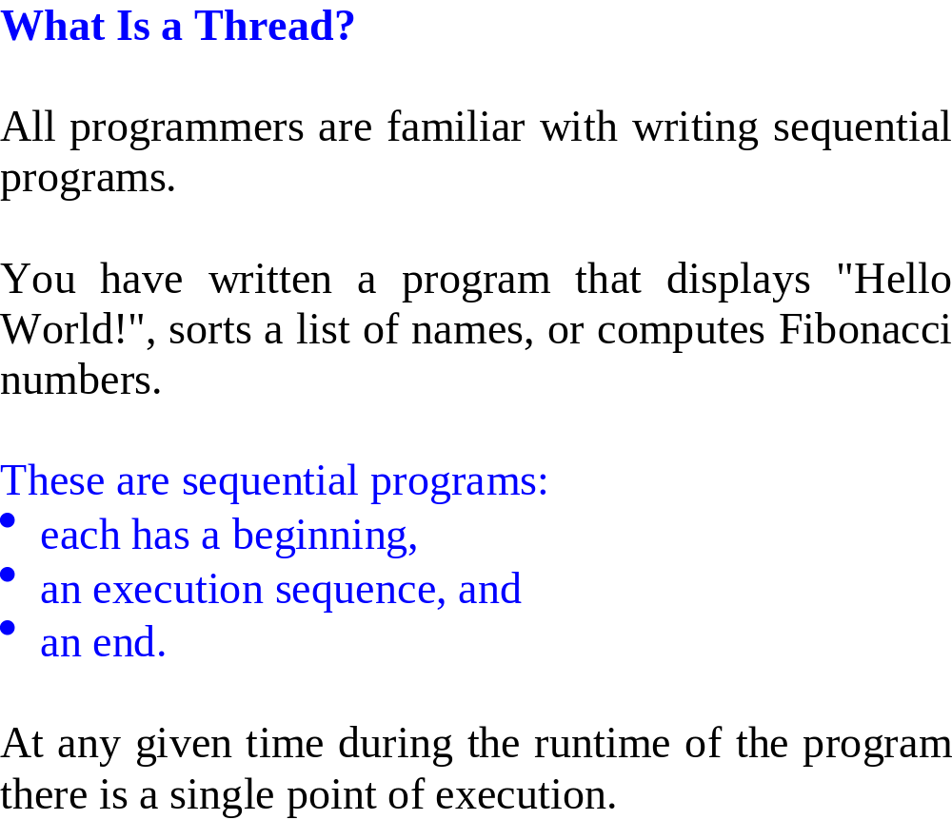

Slide 3
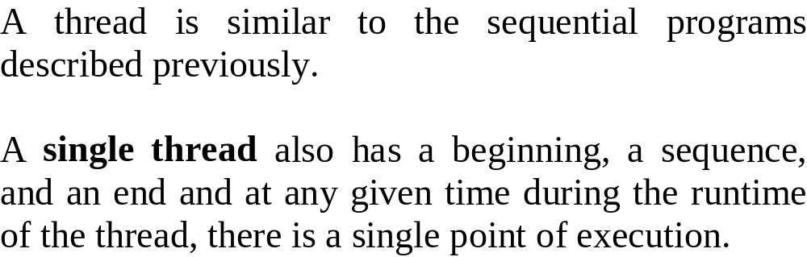

Slide 4
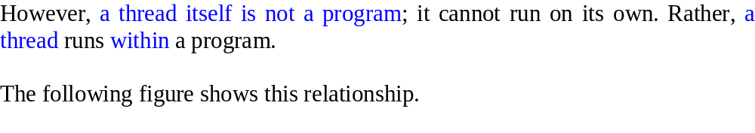
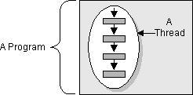

Slide 5
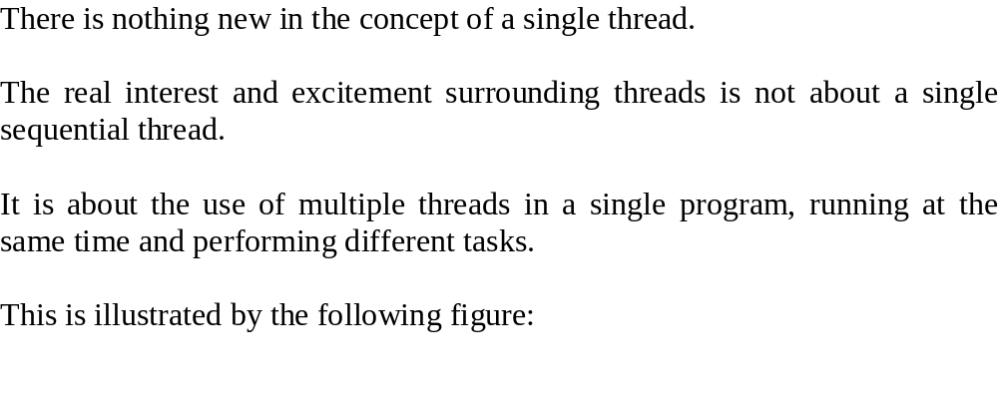
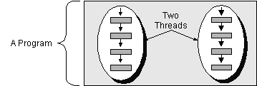

Slide 6
Multitasking is the operation of several programs running simultaneously on a single computer
  Each executable has its own memory space
  There is a moderate level of overhead associated with context switching between processes
Multithreading is the operation of several execution paths running simultaneously within a single application
  Threads can access the same application memory
  There is a lower level of overhead associated with context switching between threads
Every applet or application has at least one thread
When used appropriately, the creation of additional threads can provide efficiency and simplicity to otherwise complex tasks.

Slide 7
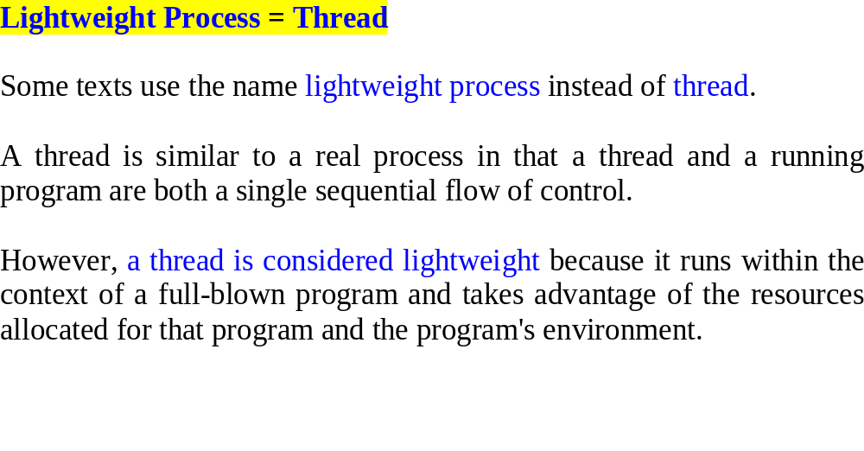

Slide 9
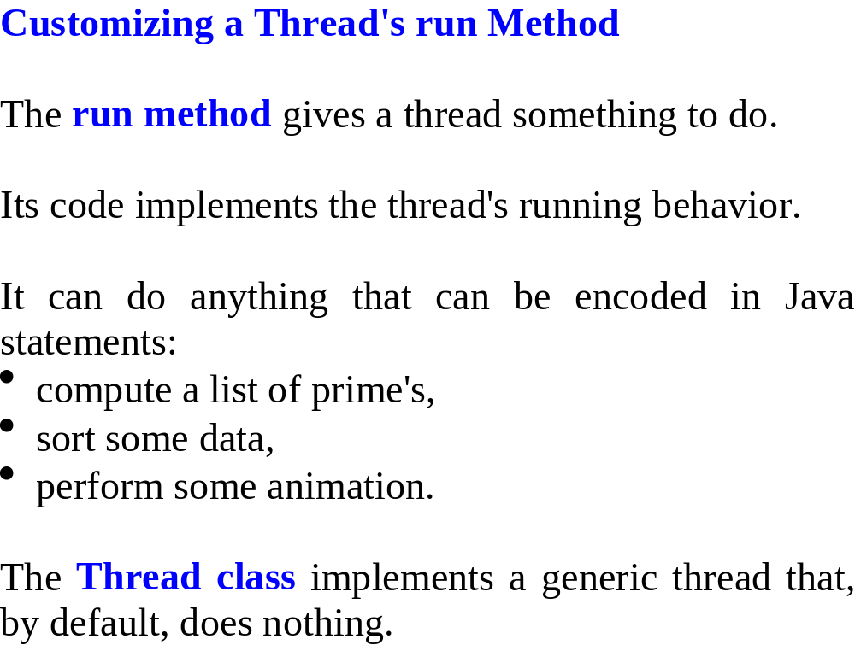

Slide 10
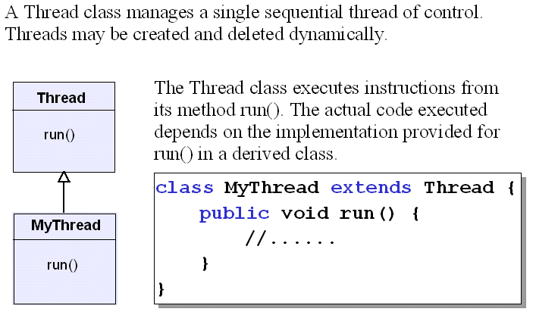

Slide 11
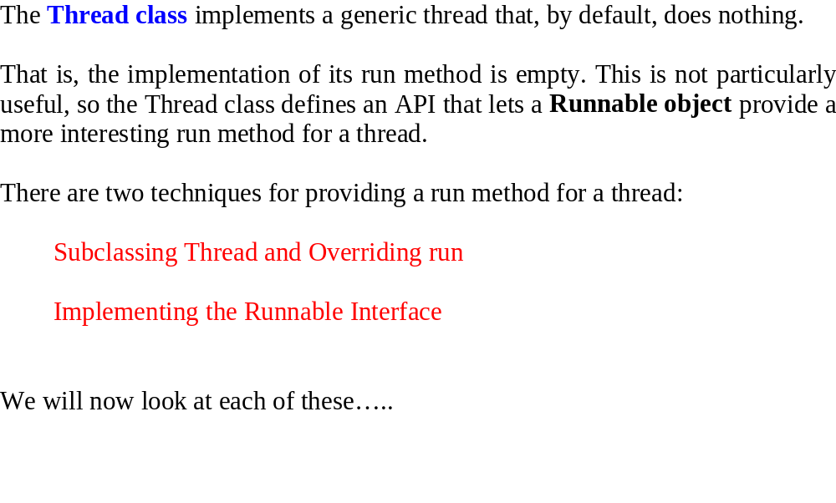

Slide 12
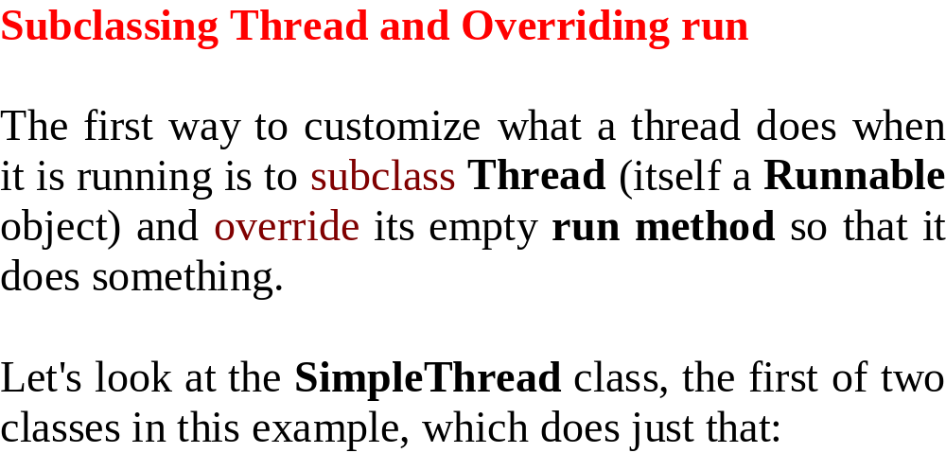

Slide 13
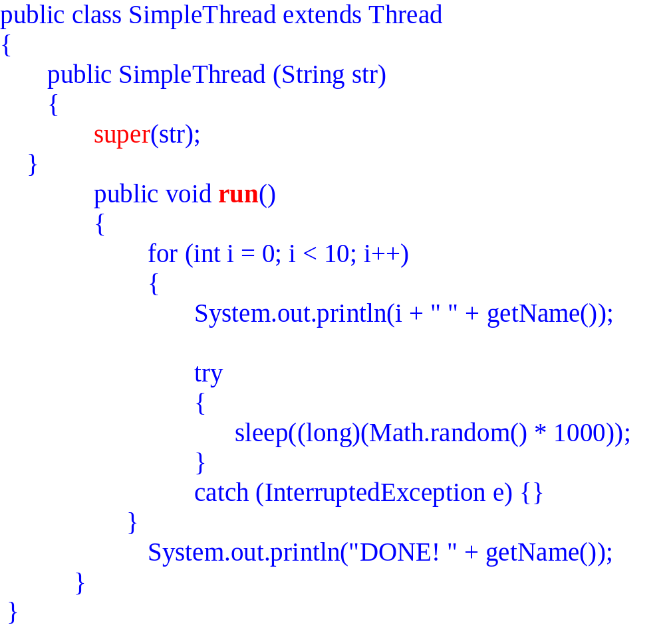
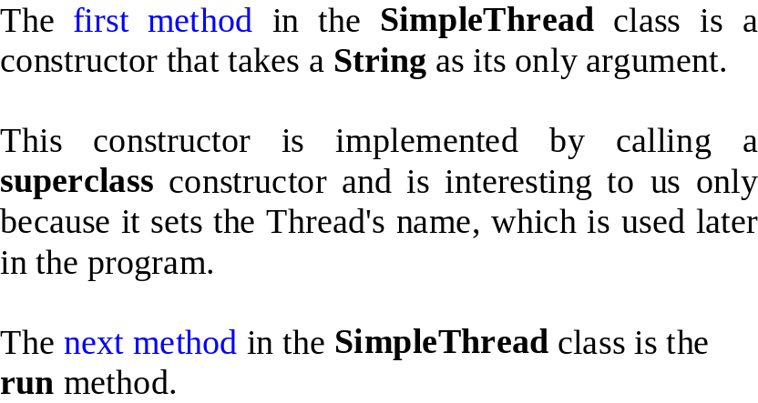

Slide 14
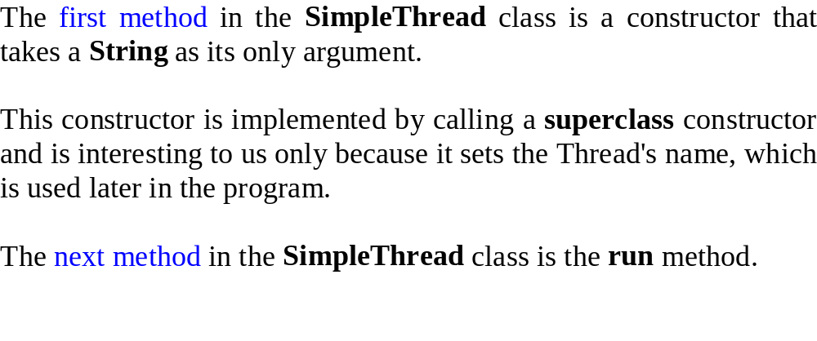

Slide 15
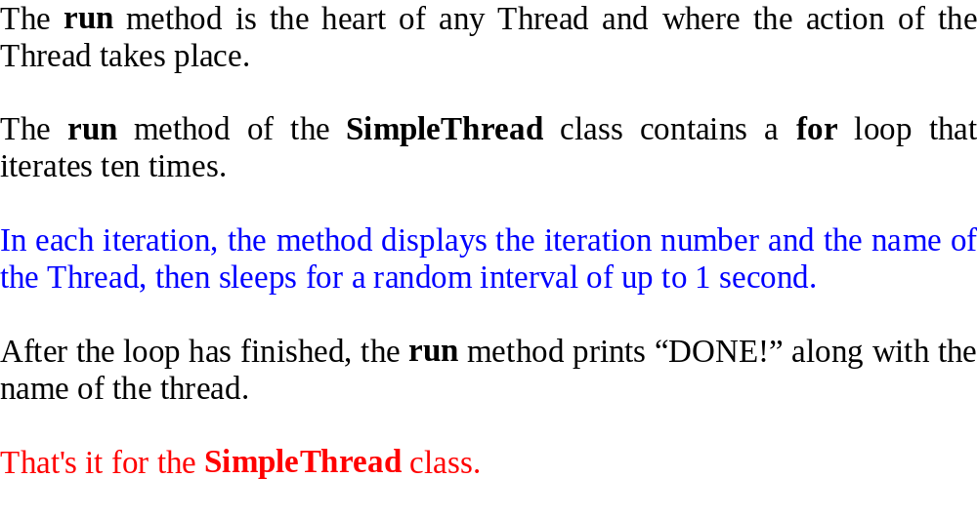

Slide 16
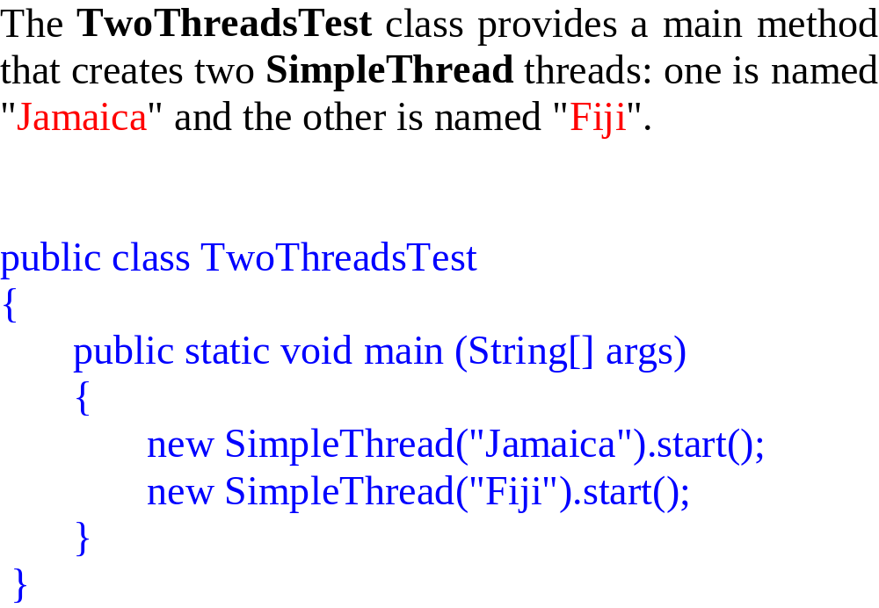

Slide 17
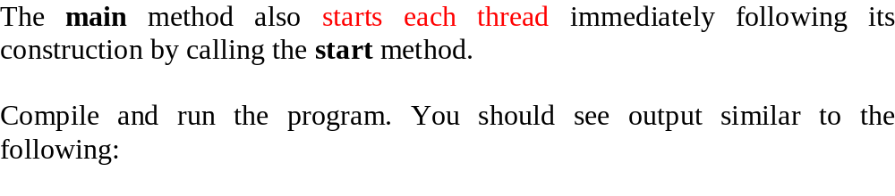
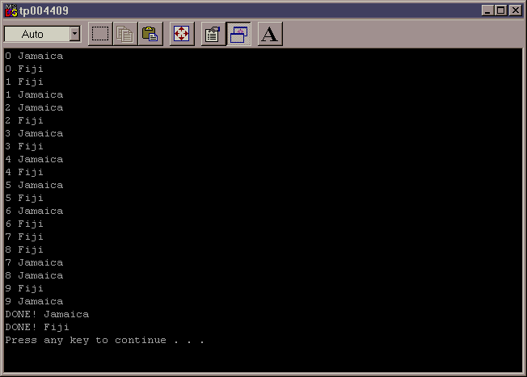
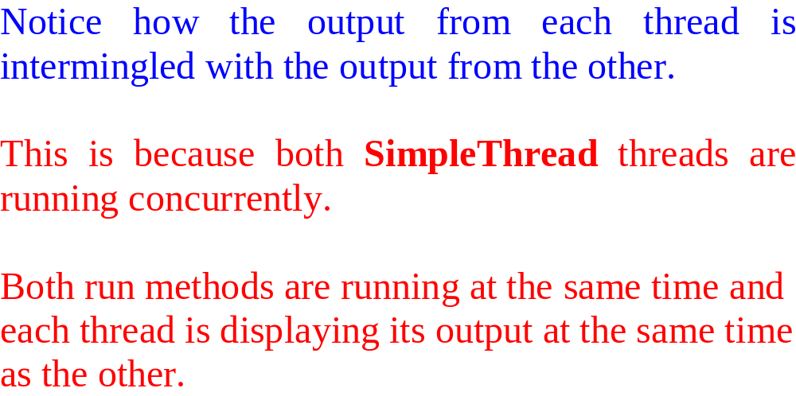

Slide 18
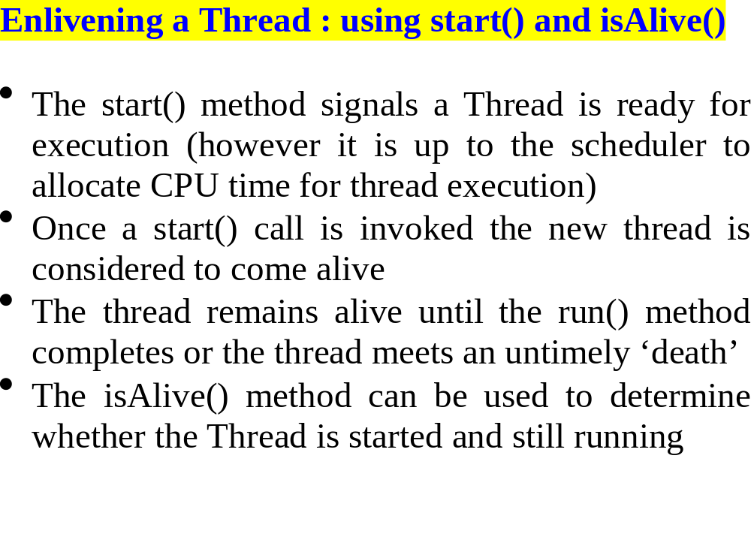

Slide 19
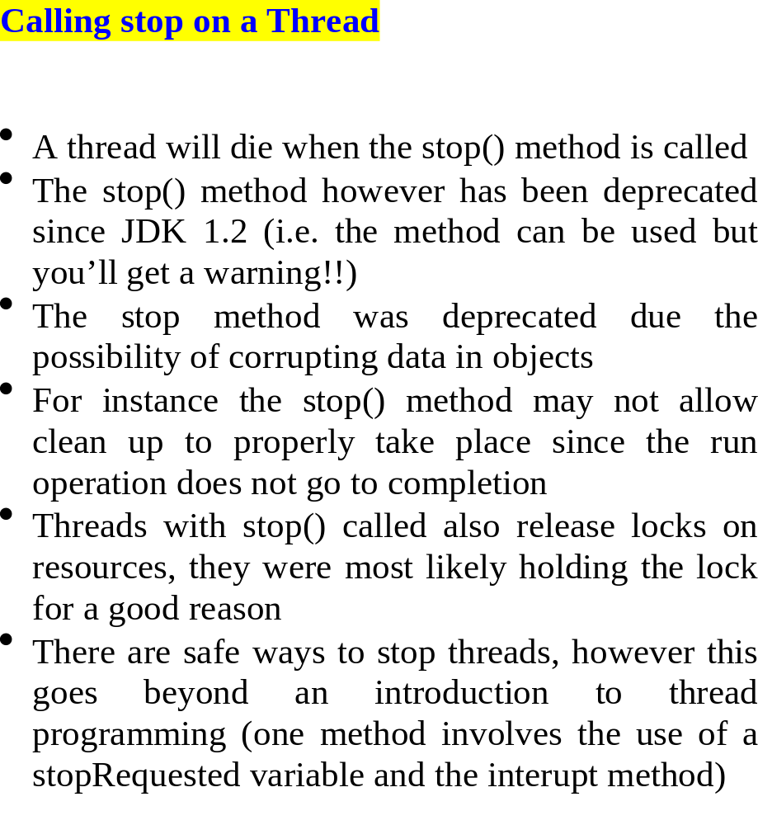

Slide 20
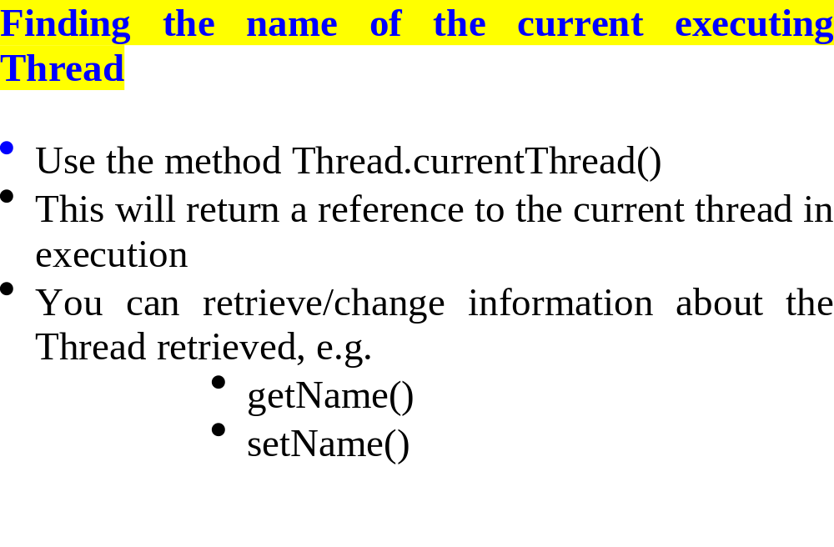

Slide 21
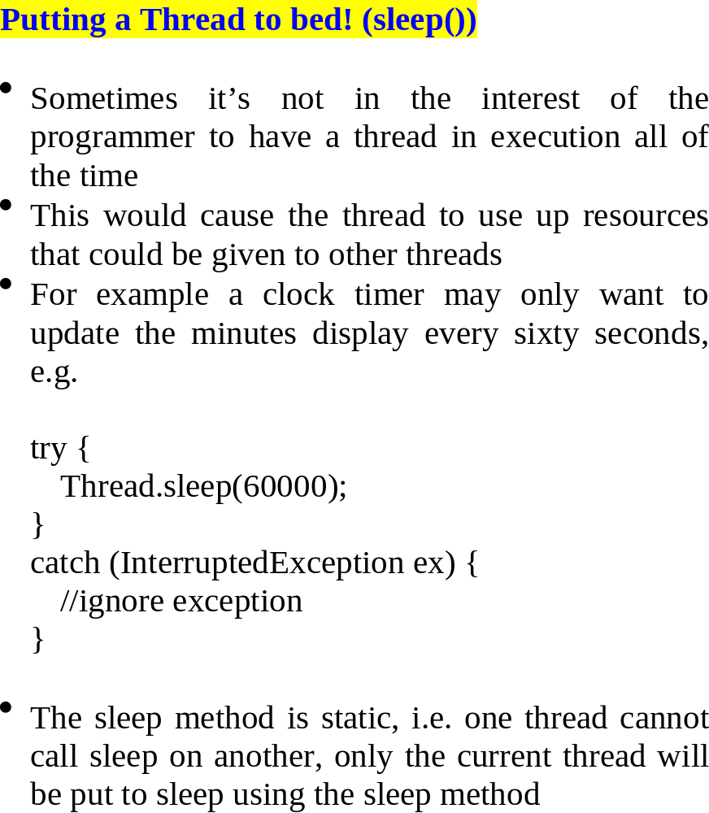
Puts the thread to bed for 60 seconds

Slide 22
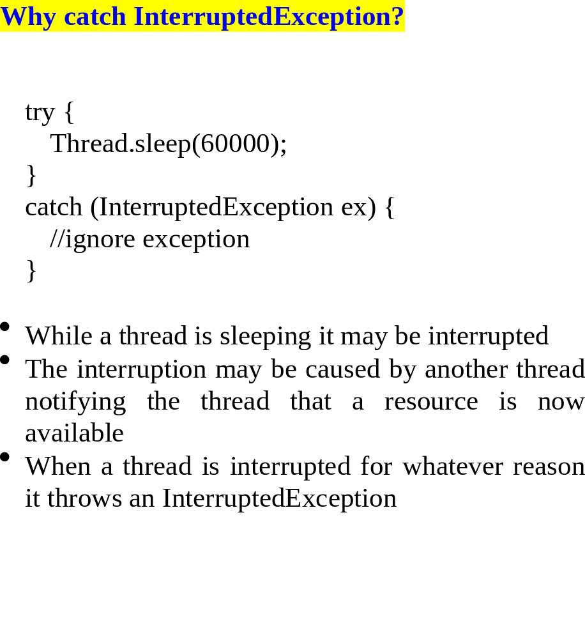

Slide 24
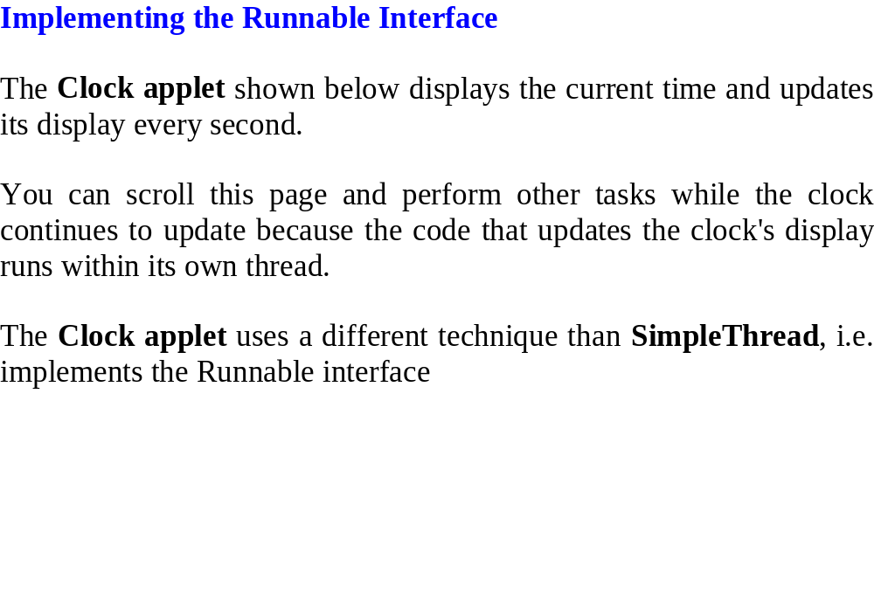

Slide 25
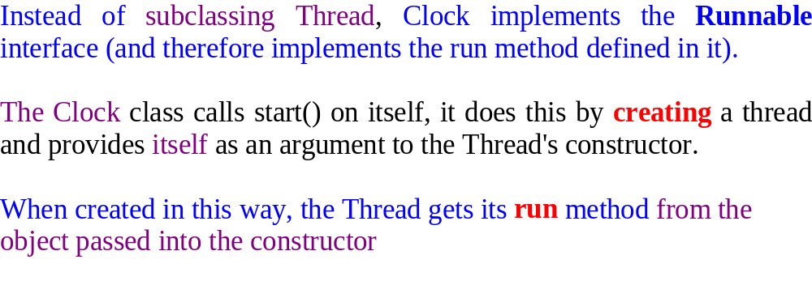
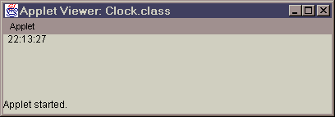


Slide 26
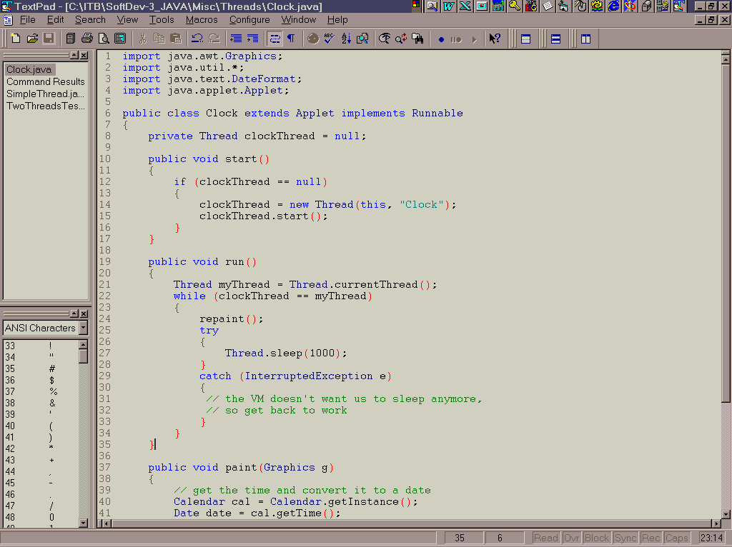

Slide 27
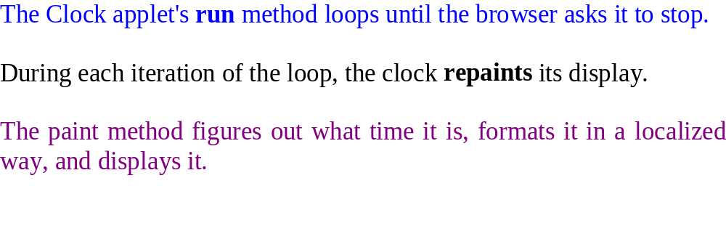

Slide 28
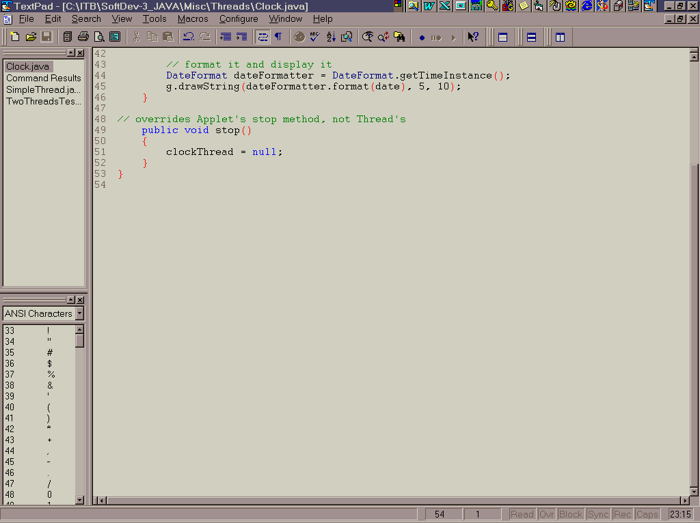

Slide 29
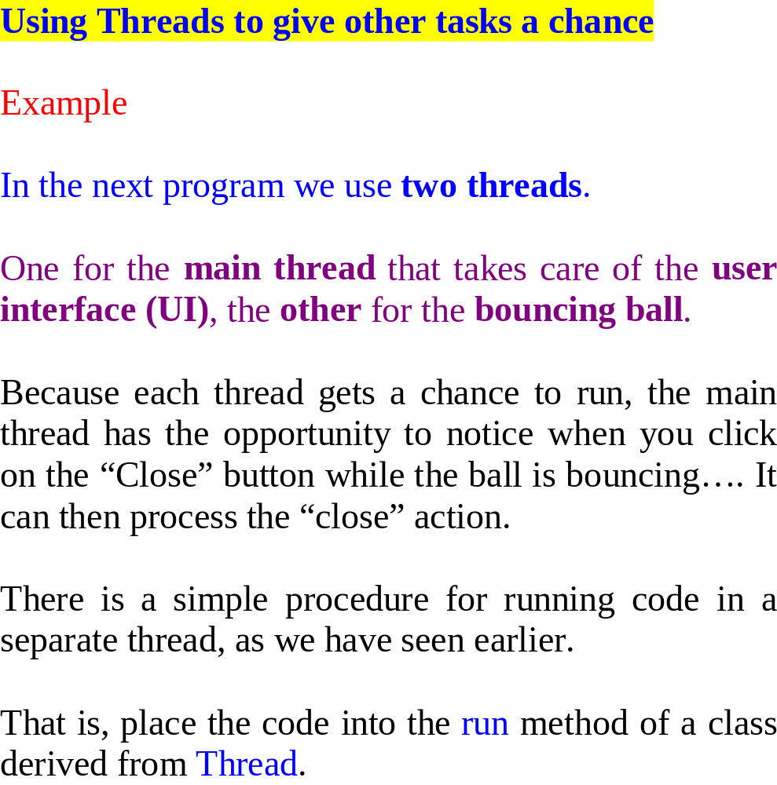

Slide 30
start
move
sleep
move
sleep

Slide 31
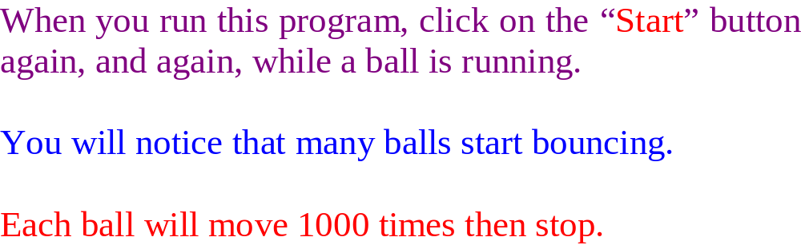

Slide 32
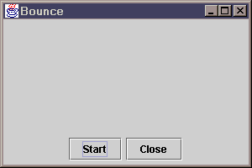
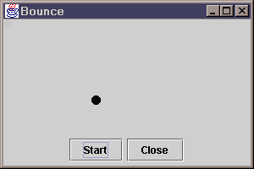
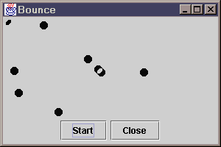
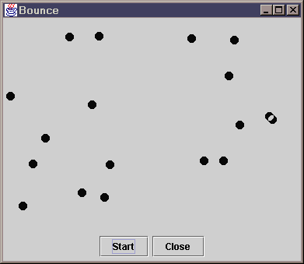
BounceThread.java

Slide 33
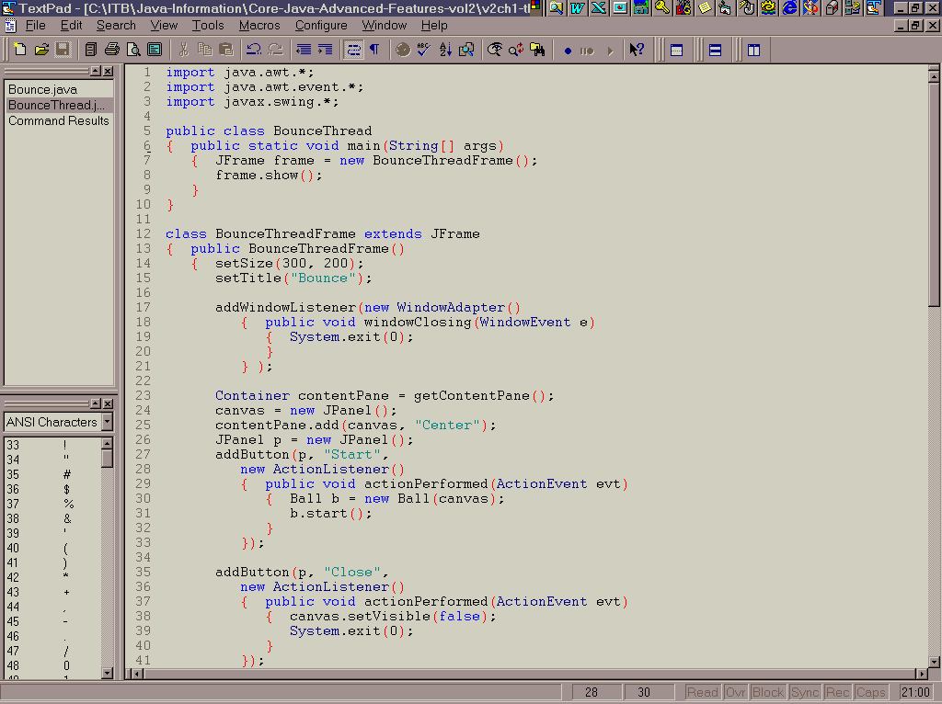

Slide 34
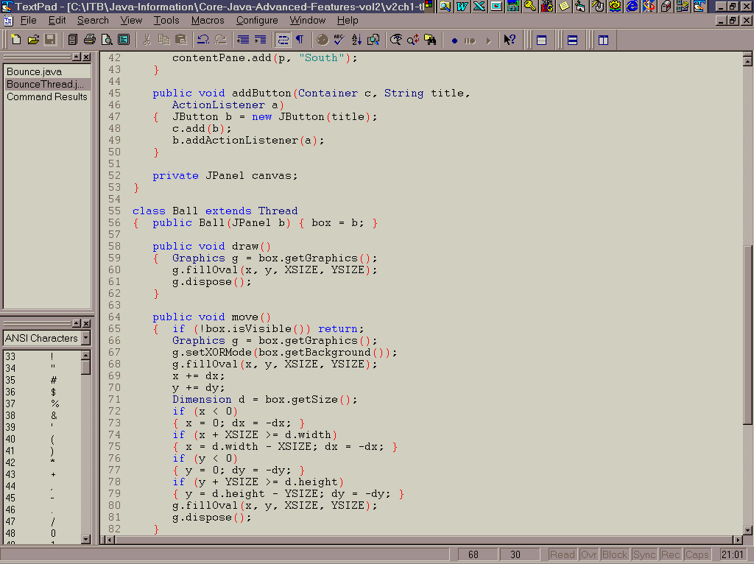

Slide 35
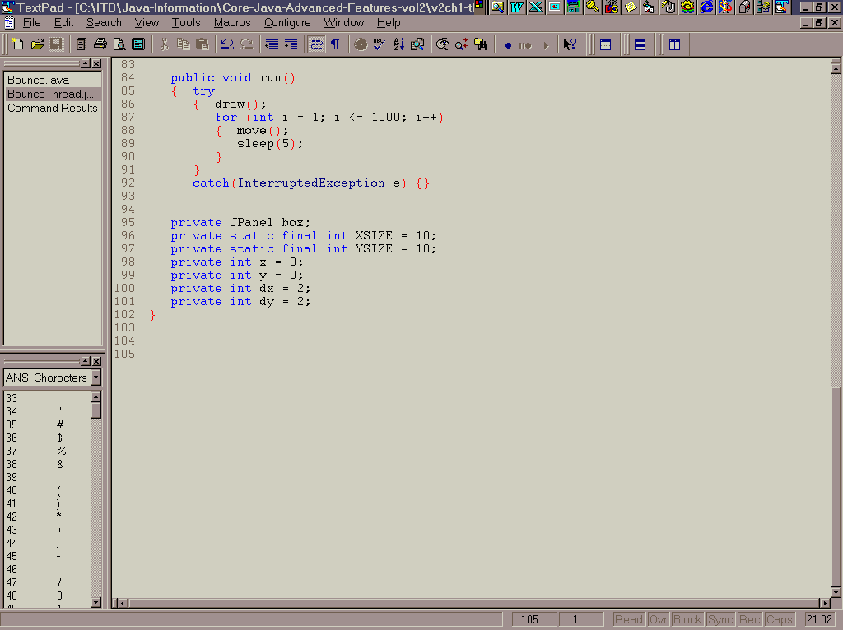

Slide 36
Now, run this next single thread program instead.
Try to click the start button over and over.
What happens?
Can you see the advantages that threads deliver.

Slide 37
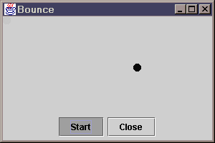
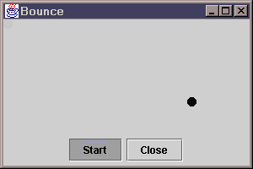
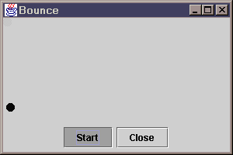
Bounce.java

Slide 38
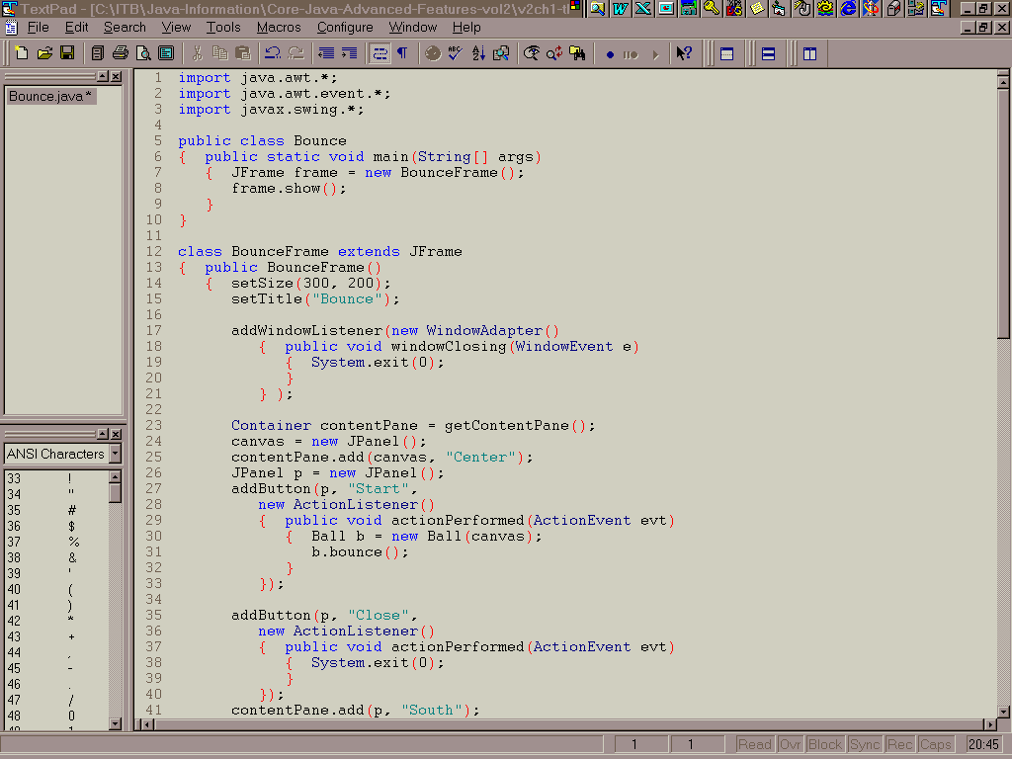

Slide 39
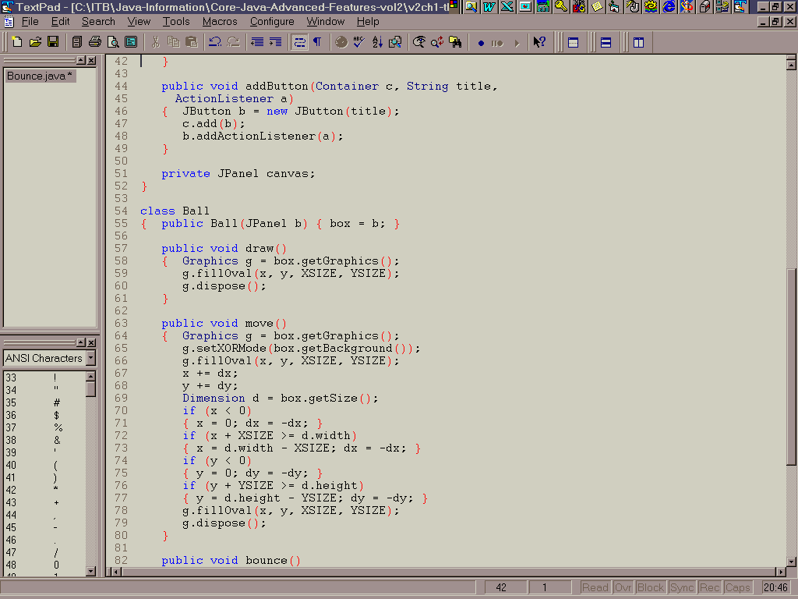

Slide 40
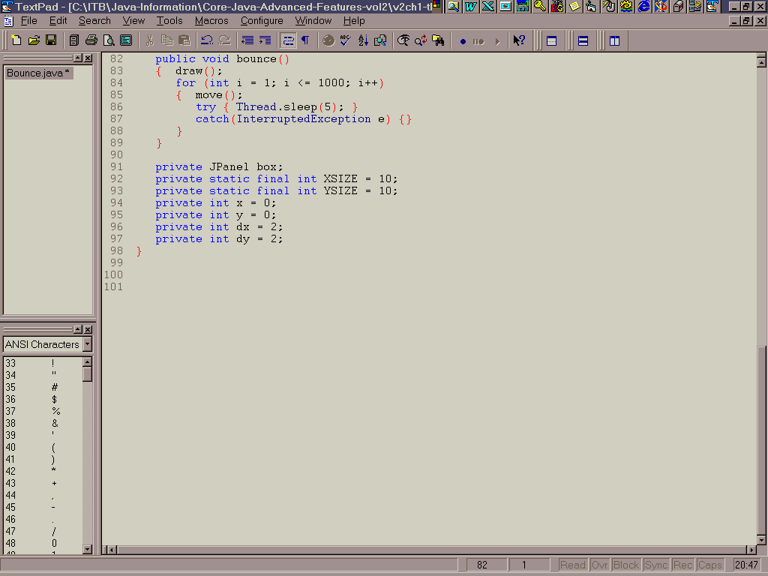

Slide 41
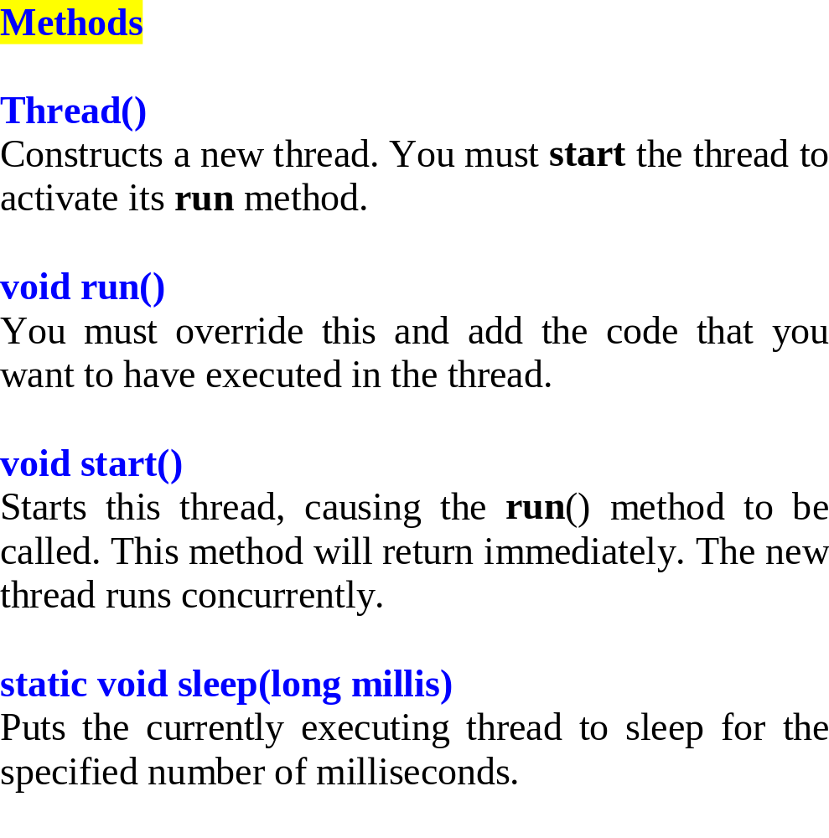

Slide 42
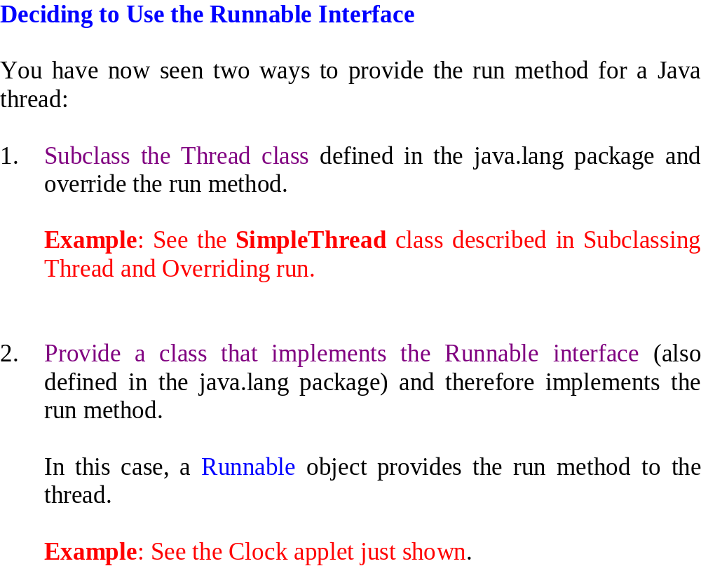

Slide 43
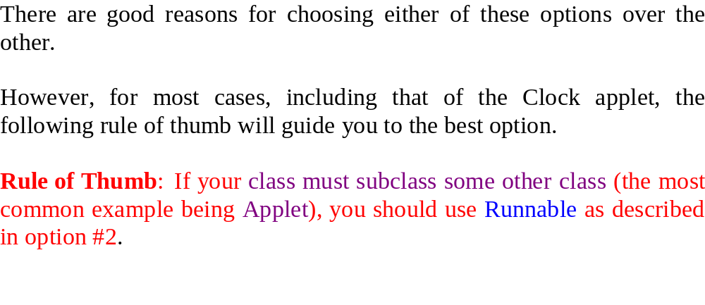

Slide 44
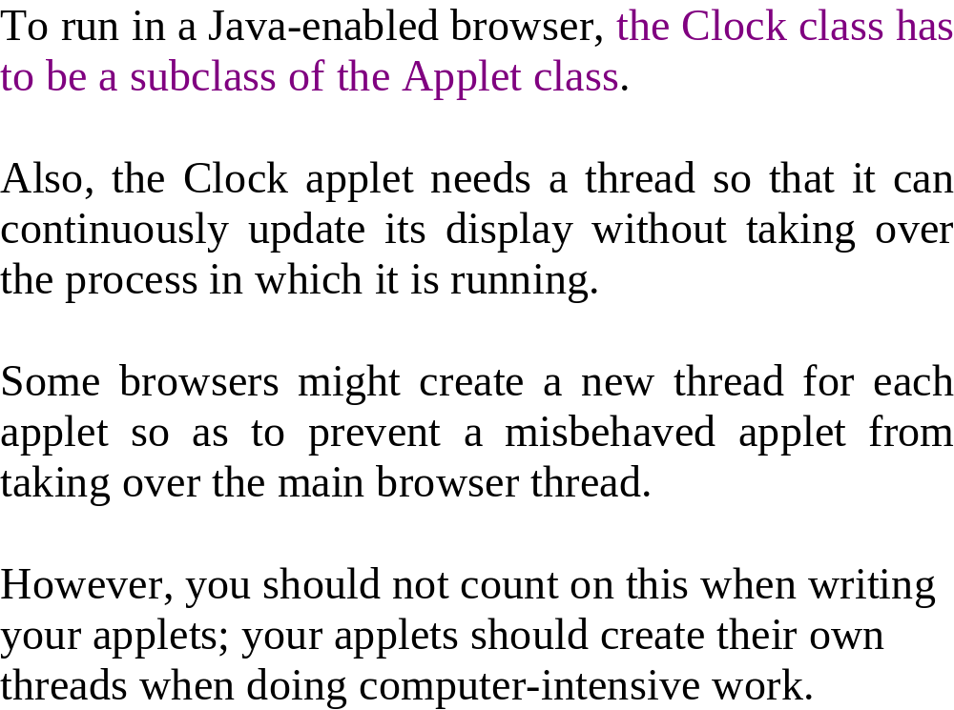

Slide 45
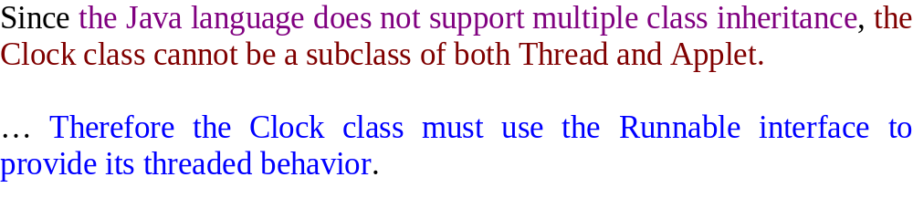


Slide 47
public class MediaPreLoader extends Thread {
URL completeURL;
String relativeURL;
AudioClip currentMedia;
public MediaPreLoader(URL mediaURL) {
completeURL = mediaURL;
start();
}
public void run() {
AudioClip audioClip = Applet.newAudioClip(completeURL);
currentMedia = audioClip;
}
}
Loading of the media
controlled by thread

Slide 48



Slide 49
Labwork Exercises
Get the examples in this lecture running.
Modify the TwoThreads example in this lecture to include and extra Thread and use the implements Runnable instead of extends Thread, e.g., create a third thread, e.g., “Hawaii” and run the test program to see the output.
Implement a simple JFrame with a JLabel that outputs a message in the JLabel, e.g., “Please wait” and then waits 10 seconds and overwrites the previous message, e.g., “Ready”.
Run the SoundApplication class contained in this lecture. Change it to run various different sound files and you will observe the loading of the media being carried out in a separate thread.

